Slide 1
SQL PORTFOLIO PROJECT
DATA BANK
SYED MUBASHIR HUSSAIN BOKHARI

Slide 2
TABLE OF CONTENTS
INTRODUCTION
DATA AVAILABLE
CASE STUDY QUESTION
  CUSTOMER NODES EXPLORATION
  CUSTOMER TRANSACTIONS
  DATA ALLOCATION CHALLENGE

Slide 3
INTRODUCTION
Innovative digital bank intersecting Neo-Banks, cryptocurrency, and data storage.
Offers secure distributed data storage alongside traditional banking services.
Focus on increasing the total customer base.
Need assistance in tracking and forecasting customers' data storage needs.
Analyzing metrics and growth to aid in better forecasting and planning for future developments.
Emphasis on smart data analysis to optimize resource allocation and customer satisfaction.

Slide 4
INTRODUCTION
Data Bank aims to leverage its unique business model to attract and retain customers in the competitive digital banking landscape.
Seeking insights and solutions to effectively manage data storage allocations and support scalable growth.

Slide 5
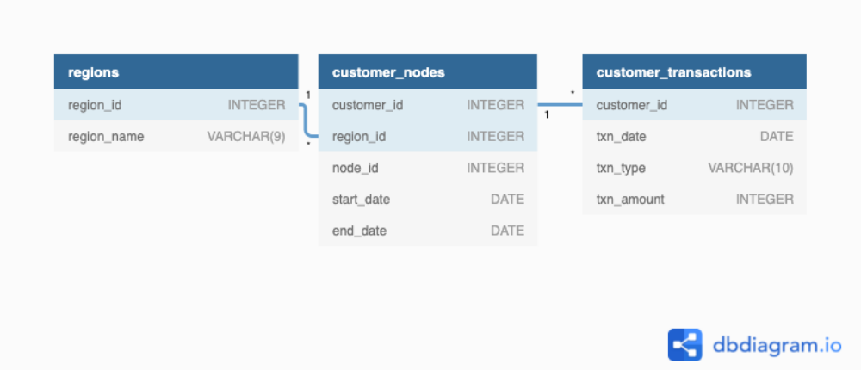
DATA AVAILABLE
THREE DATA TABLE FOR THIS CASE STUDY
  REGIONS
  CUSTOMER NODES
  CUSTOMER TRANSACTION

Slide 6
CASE STUDY QUESTIONS
CUSTOMER NODES EXPLORATION
No of unique nodes on the Data Bank system?
5 Unique Nodes
No. of Nodes per Region
Region ID | Region Name | No of Nodes
1 | Australia | 5
2 | America | 5
3 | Africa | 5
4 | Asia | 5
5 | Europe | 5

Slide 7

CASE STUDY QUESTIONS
CUSTOMER NODES EXPLORATION
Median, 80th and 95th percentile for this same reallocation days metric for each region

Slide 8
CASE STUDY QUESTIONS
CUSTOMER TRANSACTION
Unique count & Total Amount for each Transaction Type
Transaction Type | No of Transaction | Total of Transaction Amount
Deposit | 2671 | 1,359,168.00
Purchase | 1617 | 806,537.00
Withdrawal | 1580 | 793,003.00
Average total historical deposit counts and amounts for all customers
Transaction Type | Average No of Deposits | Average Deposit Amount
Deposit | 5.34 | 2718.34

Slide 9

CASE STUDY QUESTIONS
CUSTOMER NODES EXPLORATION
Data Bank customers who make more than 1 deposit and either 1 purchase or 1 withdrawal in a single month

Slide 10
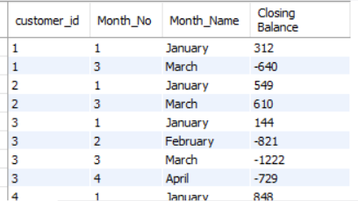
CASE STUDY QUESTIONS
CUSTOMER NODES EXPLORATION
Closing balance for each customer at the end of the month
Screenshot of few

Slide 11

CASE STUDY QUESTIONS
DATA ALLOCATION CHALLENGE
Option 2 is safe to use as it is using least amount of data.

